Slide 1
Trading Strategies

Slide 2
Plan for This Week
Icebreaker Question
This Week
Obscure and Small Markets
High Frequency Trading (HFT)
Interviewing Tips and things to learn
???

Slide 3
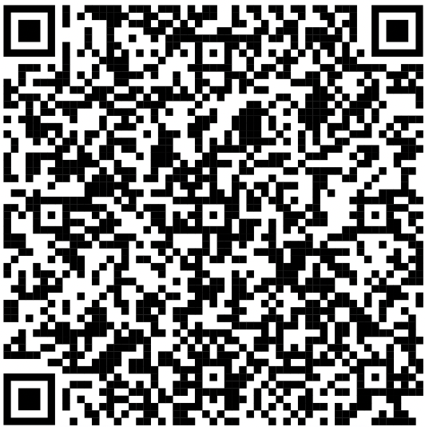
Attendance Form

Slide 4
Icebreaker Question
Leetcode Question 121 -> Best Time to Buy and Sell Stock (Easy)
Math Question -> There are 25 horses, each of which runs at a constant speed that is different from the other horses'. Since the track only has 5 lanes, each race can have at most 5 horses. If you need to find the 3 fastest horses, what is the minimum number of races needed to identify them?
Bonus -> Leetcode Question 122 -> Best Time to Buy and Sell Stock (Medium)

Slide 5
Bill Benter - Quant Horse Racing
Earned nearly $1 billion by writing a successful computer analysis software program for horse racing
Built a statistical model based on mathematics to create a formula for picking race winners
Identified factors that could lead to successful race predictions
Made $600,000 in 1988 followed by $3,000,000 after refining the model

Slide 6
Bill Benter - Quant Horse Racing
Exploited Hong Kong Betting System
1990s had 10 billion per year bet on horse racing
Winners split the pool and the house gets 17% cut
Potential factors for success
Straight line speed, size, winning record, skill of the jockey, weight of the jockey
Stored in a database the results of thousands of races
Gambler’s ruin
Even if odds are in your favor if the house has unlimited money and your funds are limited you may run out before getting the streak

Slide 7
Bill Benter - Quant Horse Racing
Limiting risk by betting more when the odds are more in your favor
For example if the model tells you that a horse with 4:1 odds should be 3:1 that is an edge you would now gain
Bad luck can be diminished by placing thousands and thousands of bets
Continued to refine the model over time and test and play with different factors out of the infinite possibilities
His biggest breakthrough was including the current betting odds as a factor for the model

Slide 8
Benefits and Risks
Far more opportunity on less popular markets
But they are less efficient
Provide consistent profits, less competition, but it is much more work
As they get exposed to larger players the profits can disappear and opportunities are gone

Slide 9
What are Obscure and Small Markets
Obscure markets refers to markets that are less popular and regulated
Small markets are markets that can only handle a small amount of trading volume without a large price movement
Big funds can only put their capital in certain regulated and large markets

Slide 10
What types of products can be traded?
Cryptocurrencies
Stock Markets in developing countries
Unregulated derivatives
Contract that has value based on some underlying entity
Orange Juice Futures
Price discrepancies in geopolitical regions
Penny stocks that can only absorb 50k before large price movements
Horse Racing, Sports Betting (SIG has a team), cattle, etc

Slide 11
Questions?

Slide 12
High Frequency Trading (HFT)
Describes trading that requires high computing and networking speeds
Usually millions of dollars are required for the software infrastructure
Uses communication speed to profit and outwit other traders
Features high communication and computing speeds, large number of trades, low profit per trade, expensive infrastructure

Slide 13
Costs of Infrastructure
Winner take all industry
If you are faster you will get rewarded with all the profits
Relative speed is more important than absolute speed
HFT funds try to be faster than their rival funds
Spend hundreds of millions on hardware and software infrastructure to reduce their computing and communication speed by milliseconds
Investing in servers directly next to one another

Slide 14
HFT Strategies - Arbitrage
Arbitrage happens when an asset is priced differently on two different exchanges
Common approaches
Approach one buy asset A on exchange x and short asset A on exchange y -> expect convergence
Buy asset A on exchange x and transfer it to exchange y and sell it there for more money (risk is time and costs)
Ideally it should be risk free in practice it is usually low risk

Slide 15
HFT Strategies - Arbitrage
Risks : Time, Exchange, Counterparty, Regulation, Country-related, Execution, liquidity, and default risk
Multiple asset exchange involving 3 currencies where prices do not quite add up
Examples: In 2017 crypto in Korea was 30% than in other countries
Gold was priced differently in 2000s between the US futures and the Japan futures

Slide 16
HFT Strategies - Reaction to News
When major news breaks the trader who reacts the fastest will win
The HFT needs to analyze the news and execute the trade before everyone else
Examples
Earnings reports (usually the drop or price rise happens instantly)
Based on futures trades happen in milliseconds
Technology glitches
Twitter

Slide 17
HFT Strategies - Latency Arbitrage
This is when a traditional fund intends to buy a large amount of stock A
The HFT fund detects that order and will then buy all the shares of stock A available
Then sell them back to the traditional fund for a small profit and higher price
The HFT fund might do this millions of times over a day
The HFT is able to see the “true” market before everyone else and capitalize on it over the day

Slide 18
HFT Strategies - Statistical Arbitrage
Much more enhanced version of pairs trading that happens at rapid speeds
Not much more to add since its essentially the same thing

Slide 19
HFT Strategies - Other Strategies
It is a very secretive industry
Once a strategy gets found the other firms will trade it and then it is no longer profitable
Market Making strategies
Index Arbitrage (when funds change their weight in certain indices)
If a HFT can find that info out they can predict the changes and sell them on a profit

Slide 20
Questions?

Slide 21
Common Interview Style Questions for Software Engineering (Prep)
Neetcode 150
Leetcode more (I recommend the contests in the leetcode archives to get a random mix of easy/medium/medium/hard in a timed setting
Leetcode some more
Learn what a matching engine is (I have been asked to build or discuss them in multiple interviews)
Read up on System Design (OOP Principles, Operating Systems, Networking, Distributed Systems, etc)
If you are aiming for the top top firms read a book on C++

Slide 22
Common Interview Questions for Quant Trading
Probability
Basic Random Variables (Uniform, Geometric, Binomial, Normal, Poisson)
Expectation of Random Variables and Functions of Random Variables
Random Walks
Expected Value
Markov Chains
Combinatorics
Permutations, Combinations
Games
Board Games
Learn Poker Strategy
Algebra

Slide 23
Sources
https://algotrading101.com/learn/quantitative-trading-strategies/
https://www.bloomberg.com/news/features/2018-05-03/the-gambler-who-cracked-the-horse-racing-code

